Slide 1
Linearity vs Additivity
Statsjam | September 26, 2022, | Jack Stanley

Slide 2
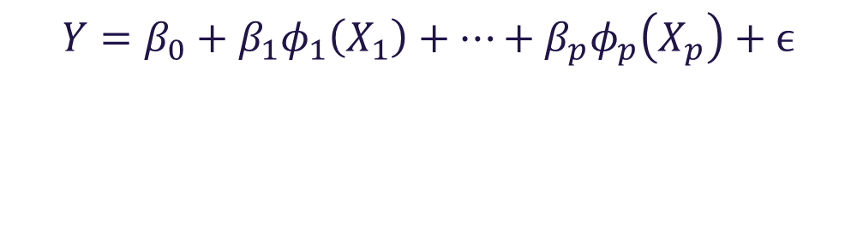
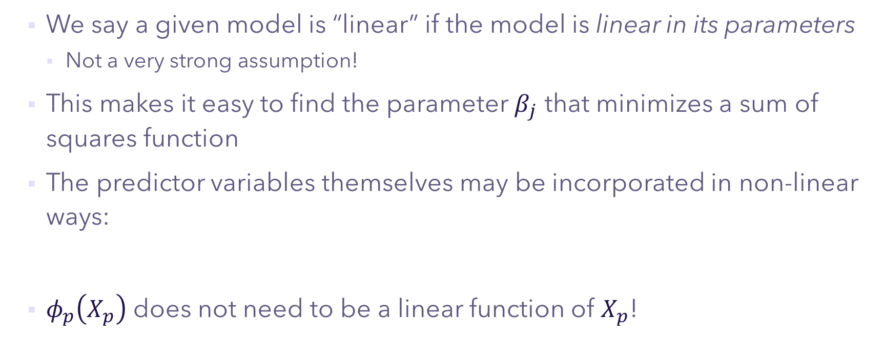
Linearity
We say a given model is “linear” if the model is linear in its parameters
Not a very strong assumption!
This makes it easy to find the parameter $β_{j}$ that minimizes a sum of squares function
The predictor variables themselves may be incorporated in non-linear ways:
$φ_{p}\left(X_{p}\right)$ does not need to be a linear function of $X_{p}$!
$$Y=β_{0}+β_{1}φ_{1}\left(X_{1}\right)+…+β_{p}φ_{p}\left(X_{p}\right)+ϵ$$

Slide 3
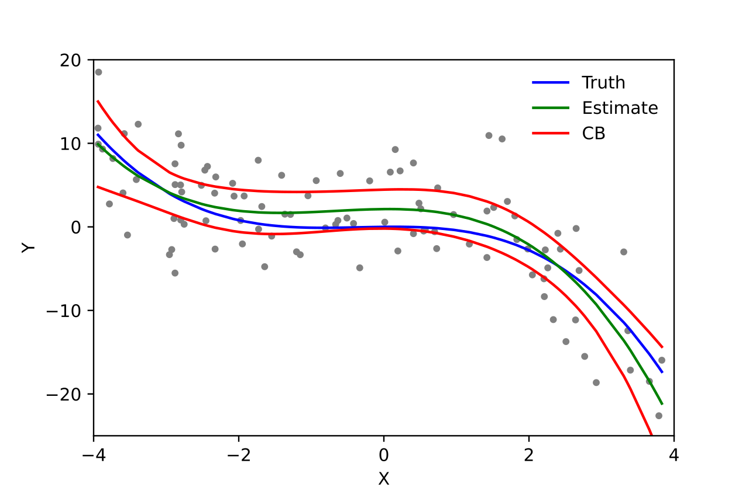
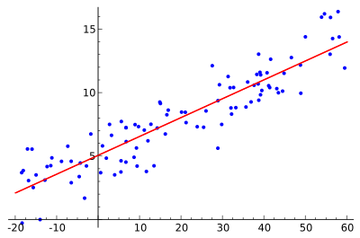


Linearity Examples
“Linear” models can model very diverse sets of functions:
Simple linear regression
Polynomial regression
$$\hat{Y}=β_{0}+β_{1}\left(X_{1}\right)$$
$$\hat{Y} =β_{0}+β_{1}\left(X_{1}\right)+β_{2}\left(X_{2}^{2}\right)+β_{3}\left(X_{3}^{3}\right)$$

Slide 4

Detour: Regression
What is “regression” anyway?
Broadly: using one or more predictor variables to model the distribution of one or more outcome variables
Regression doesn’t have to be linear; in fact there is nothing special about linear regression other than its convenience for solving sum of squares functions
For example, we could relate the parameters of our regression exponentially:
$$Y=β_{0}e^{β_{1}X}+ϵ$$

Slide 5
Additivity
For a given model to be additive, then the effect of a change in one of the predictors on the response must be independent of the values of the other predictors
This is a different assumption than linearity in the parameters!
In fact, linear models can include non-additive effects, and non-linear models can be entirely additive

Slide 6


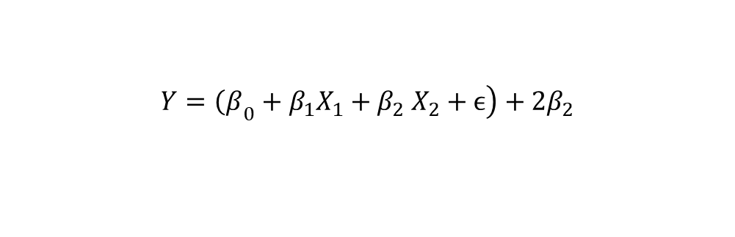
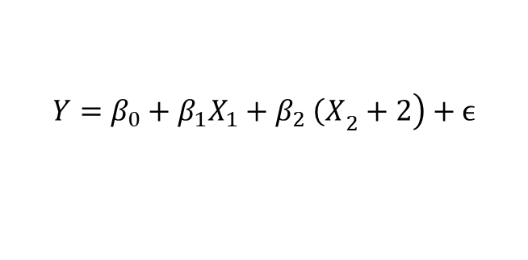
Additivity Breakdown
Starting with a linear regression:
We can easily see that increasing${ X}_{2}$ by 2 does not change the contribution from $X_{1}$ on the response:
$$Y=β_{0}+β_{1}X_{1}+β_{2} X_{2}+ϵ$$
$$\left.Y=β_{0}+β_{1}X_{1}+β_{2} {\left(X\right.}_{2}+2\right)+ϵ$$
$$\left.Y={\left(β\right.}_{0}+β_{1}X_{1}+β_{2} X_{2}+ϵ\right)+{2β}_{2}$$
$$Y=Y+{2β}_{2}$$

Slide 7
Additivity Examples
Nonlinear and additive:
Linear and non-additive:
Nonlinear and non-additive:
$$Y=β_{0}+e^{β_{1}X_{1}}+β_{2}X_{2}+ε$$
$$Y=β_{0}+β_{1}X_{1}+β_{2}X_{2}+β_{3}X_{1}X_{2}+ε$$
$$Y=β_{0}+e^{β_{1}X_{1}}+β_{2}X_{2}+β_{3}X_{1}X_{2}+ε$$

Slide 8
Caution
Classically, linear regression assumes additivity in the predictors
But, we can cheat a little by adding in interaction terms:
This makes our model a bit less interpretable (additive models are very interpretable), and it may not capture the full array of interactions present
$$Y=β_{0}+β_{1}X_{1}+β_{2}X_{2}+β_{3}X_{1}X_{2}+ε$$

Slide 9
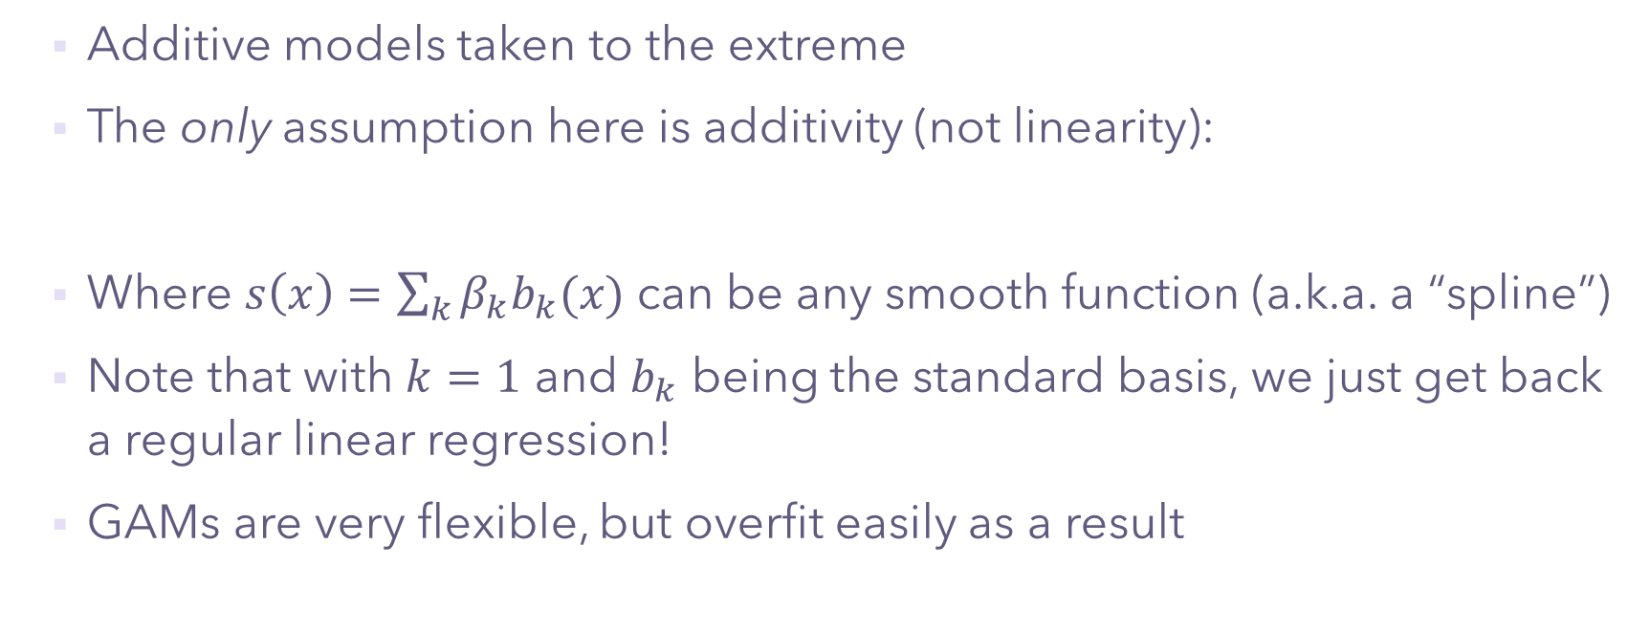
Generalized Additive Models (GAMs)
Additive models taken to the extreme
The only assumption here is additivity (not linearity):
Where $s\left(x\right)=\sum_{k}{β_{k}b_{k}(x)}$ can be any smooth function (a.k.a. a “spline”)
Note that with $k=1$ and $b_{k}$ being the standard basis, we just get back a regular linear regression!
GAMs are very flexible, but overfit easily as a result
$$Y=s_{0}X_{0}+s_{1}X_{1}+…+s_{p}X_{p}+ε$$

Slide 10
☺ Done! ☺

